Slide 2
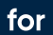

ENGINEERING MACHINE LEARNING
HEALTH TECHNOLOGY
THE KERNEL TRICK
+
EXPLAINABLE AI

Slide 3

MACHINE LEARNING for Health tech
THE KERNEL TRICK CONCEPT
Non-linear problem transforms into linear problem in higher dimensional space!

Slide 4
MACHINE LEARNING for Health tech
THE KERNEL TRICK IN SVM
The kernel tricks lets us compute the higher dimensional solution without actually working in the higher dimensional space!

Slide 5
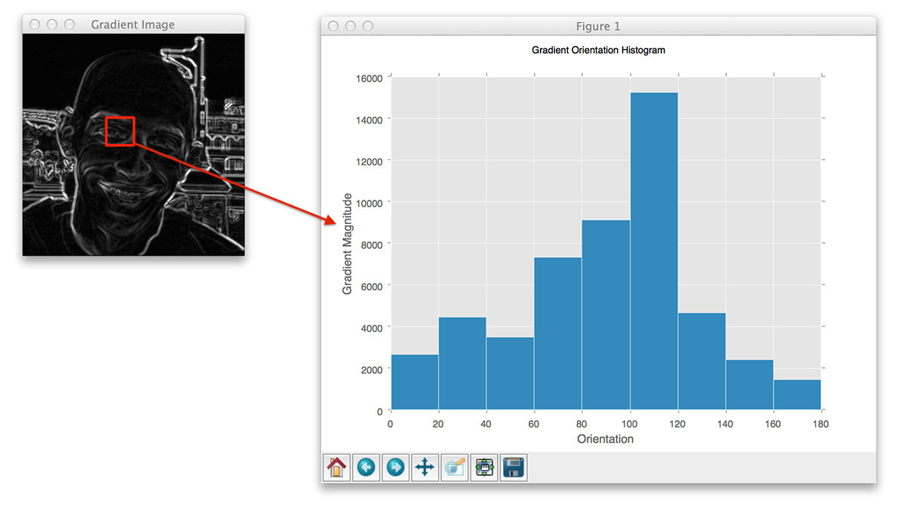
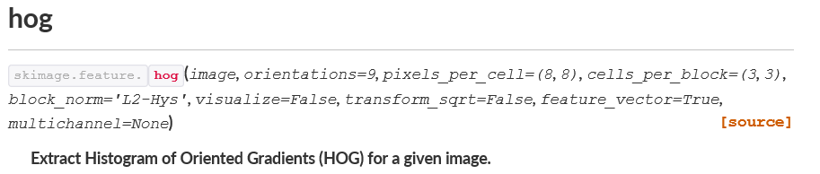
MACHINE LEARNING for Health tech
BETTER FEATURES EXAMPLE

Slide 6
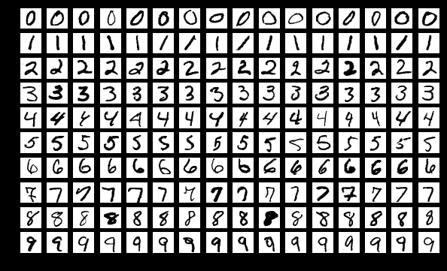
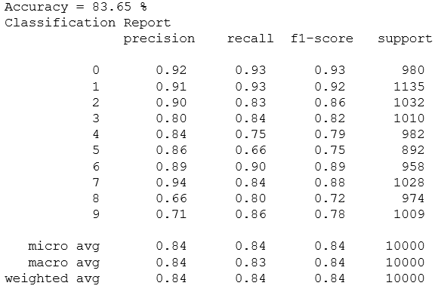
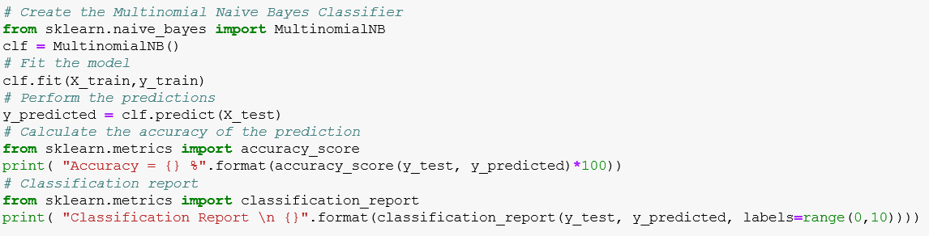
MACHINE LEARNING for Health tech
BETTER FEATURES EXAMPLE
Baseline (raw pixel features)
MNIST
dataset

Slide 7
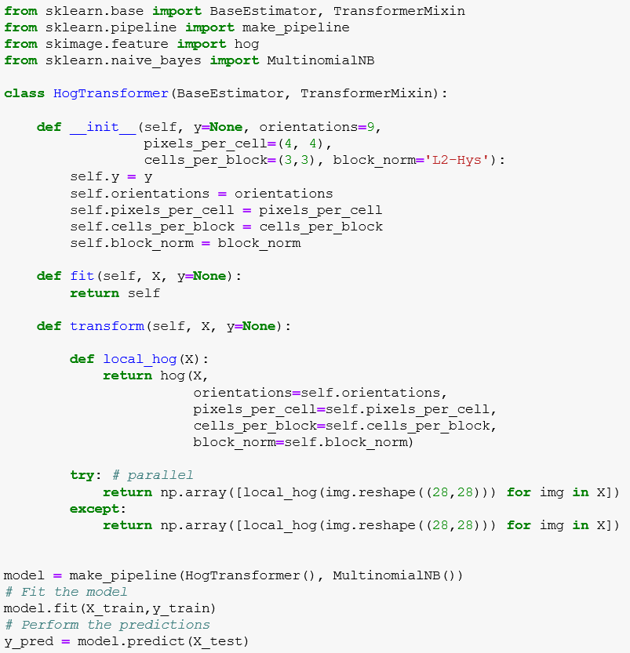
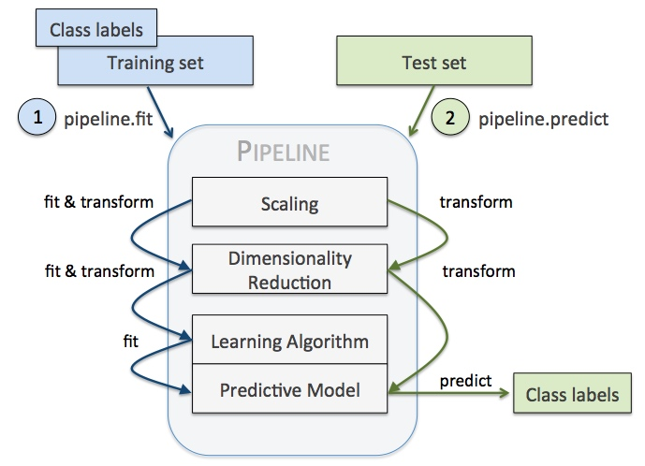
MACHINE LEARNING for Health tech
BETTER FEATURES EXAMPLE

Slide 8
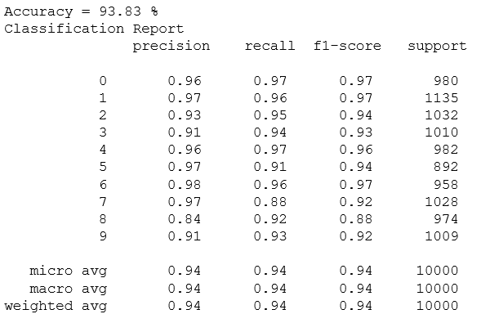
MACHINE LEARNING for Health tech
BETTER FEATURES EXAMPLE

Slide 9
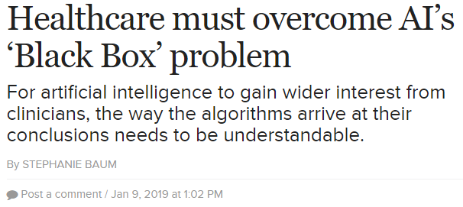
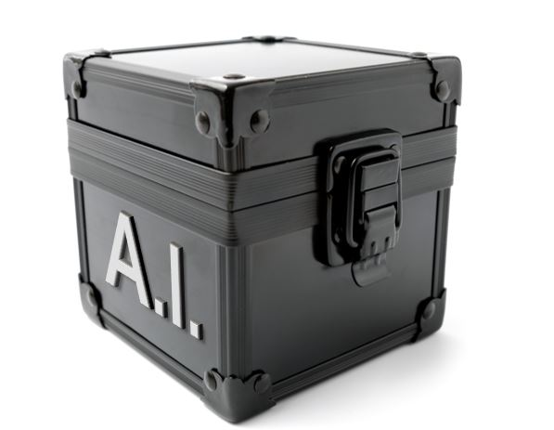
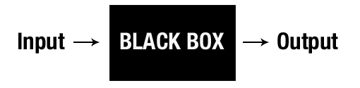
MACHINE LEARNING for Health tech
MACHINE LEARNING EXPLAINABILITY

Slide 10
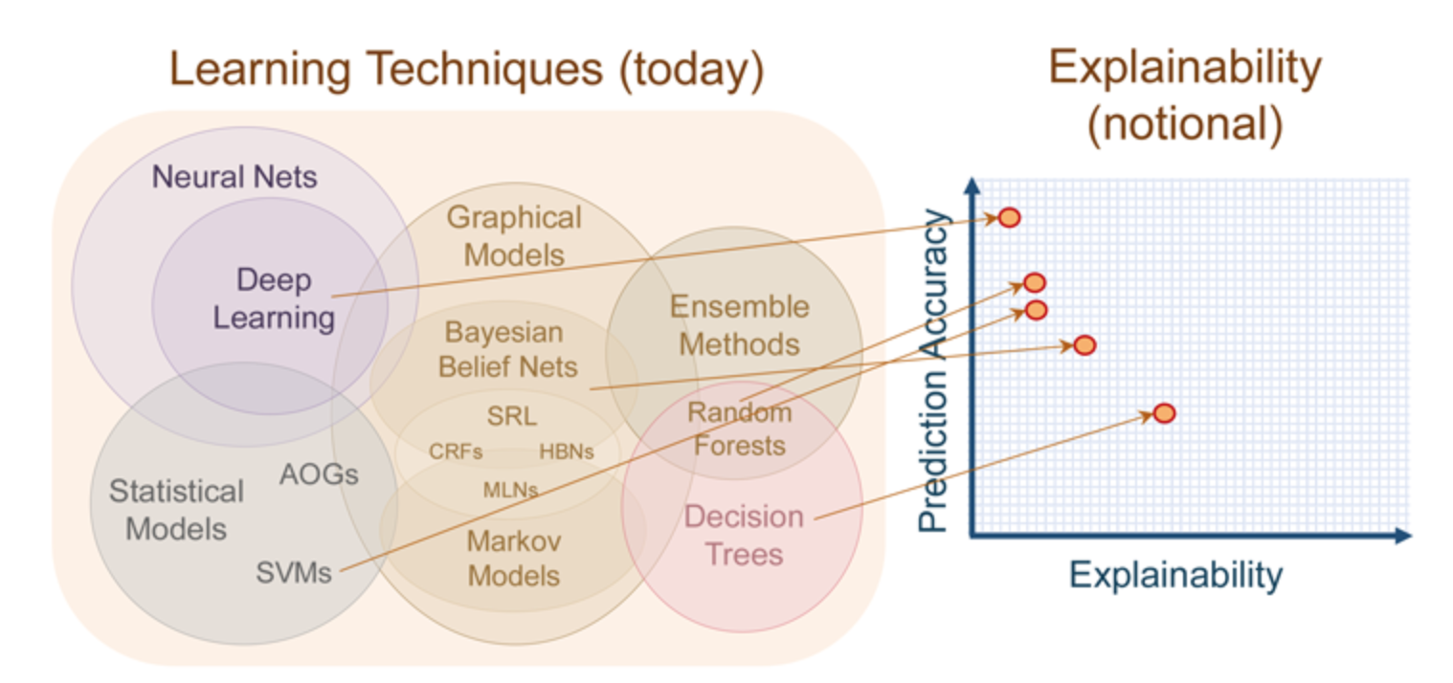
MACHINE LEARNING for Health tech
MACHINE LEARNING EXPLAINABILITY
https://medium.com/@Zelros/a-brief-history-of-machine-learning-models-explainability-f1c3301be9dc

Slide 11
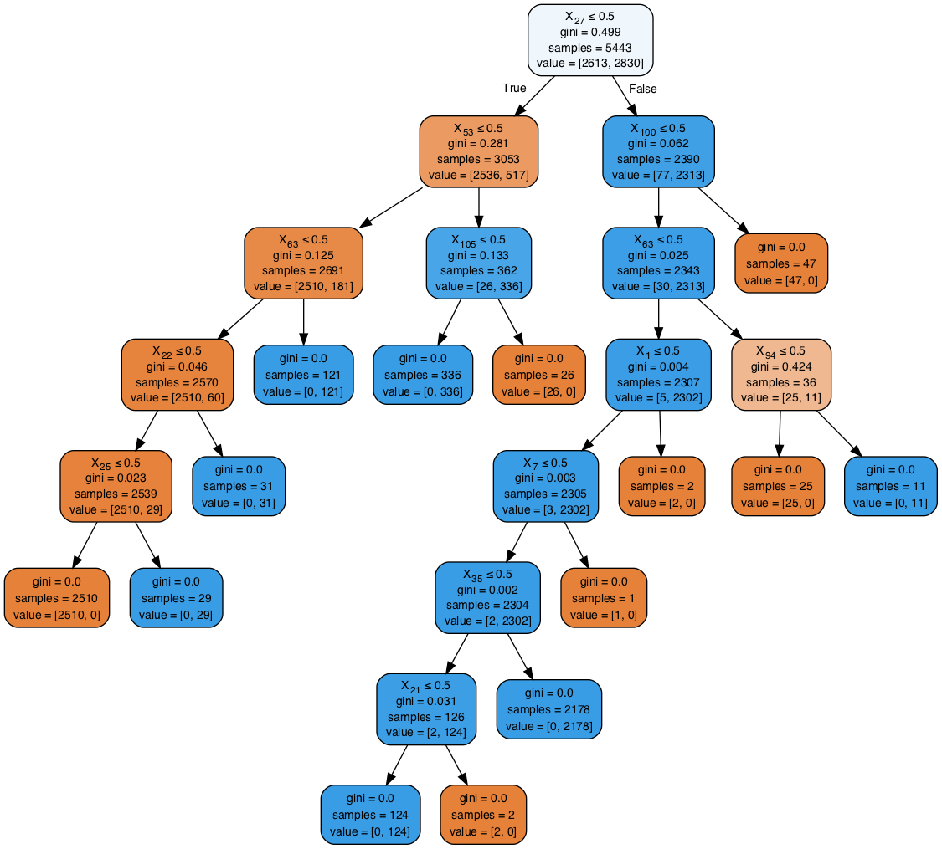
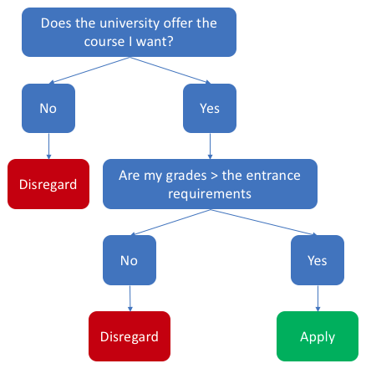
MACHINE LEARNING for Health tech
MACHINE LEARNING EXPLAINABILITY
A Decision Tree is intuitively explainable
https://towardsdatascience.com/decision-trees-understanding-explainable-ai-620fc37e598d

Slide 12
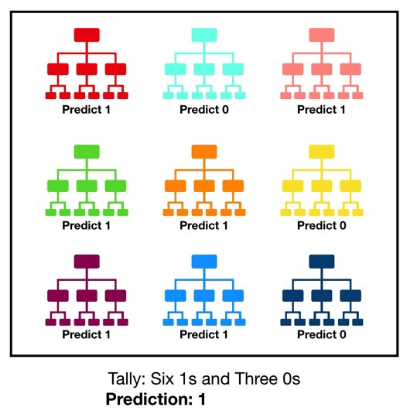
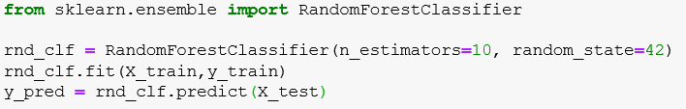
MACHINE LEARNING for Health tech
MACHINE LEARNING EXPLAINABILITY
A Random Forest is an ensemble of Decision Trees

Slide 13
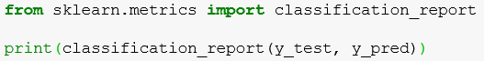
MACHINE LEARNING for Health tech
MACHINE LEARNING EXPLAINABILITY

Slide 14
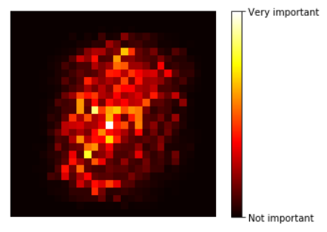
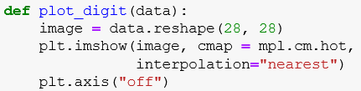
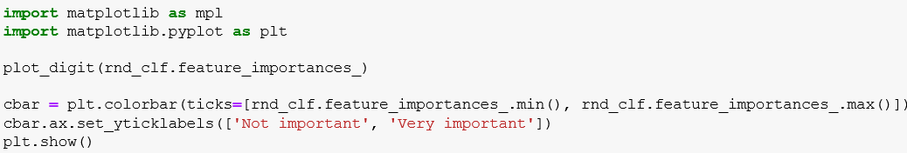
MACHINE LEARNING for Health tech
MACHINE LEARNING EXPLAINABILITY

Slide 15
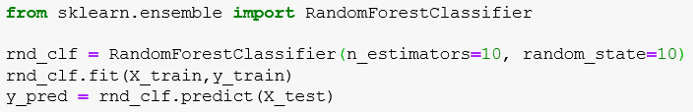
MACHINE LEARNING for Health tech
MACHINE LEARNING EXPLAINABILITY

Slide 16
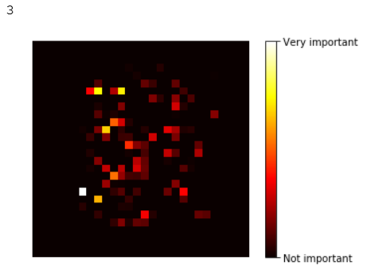
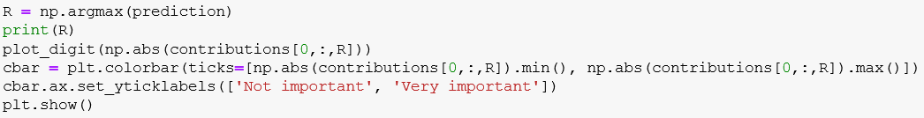
MACHINE LEARNING for Health tech
MACHINE LEARNING EXPLAINABILITY
What about a single prediction?
What if there was some dirt on the image right here?
Would prediction fail?

Slide 17

MACHINE LEARNING for Health tech
MACHINE LEARNING EXPLAINABILITY - LIME
https://www.youtube.com/watch?v=hUnRCxnydCc

Slide 18
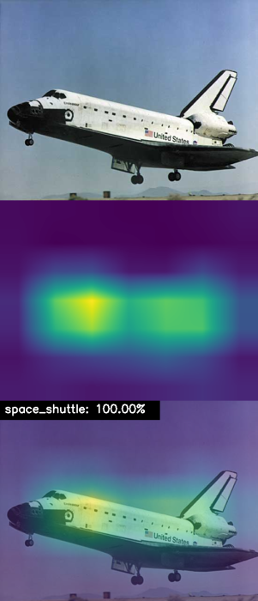
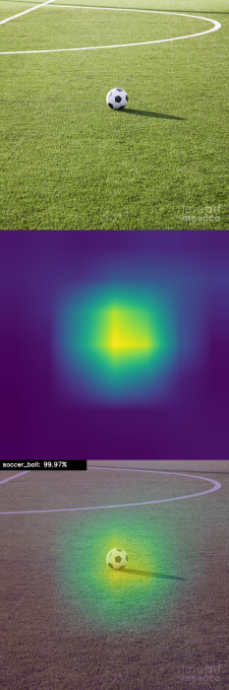
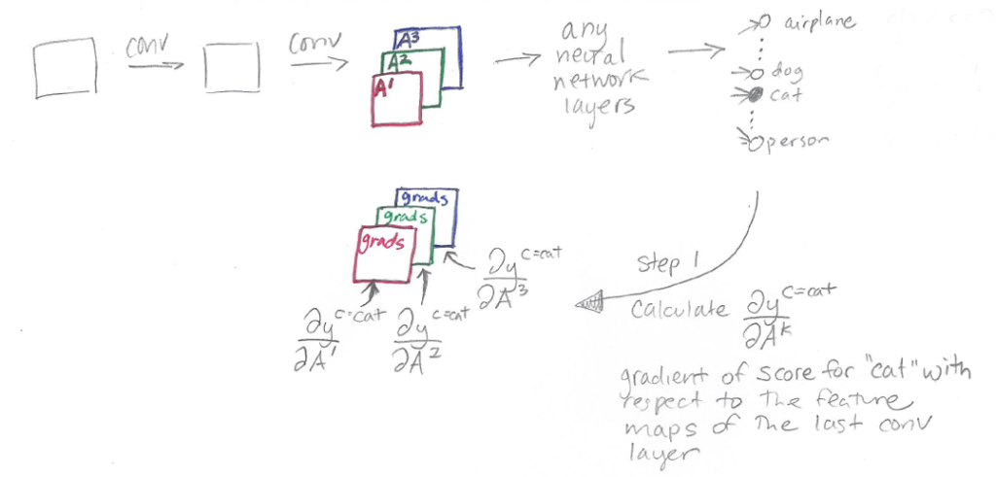
MACHINE LEARNING for Health tech
MACHINE LEARNING EXPLAINABILITY – GRAD-CAM
https://glassboxmedicine.com/2020/05/29/grad-cam-visual-explanations-from-deep-networks/
https://christophm.github.io/interpretable-ml-book/

Slide 19
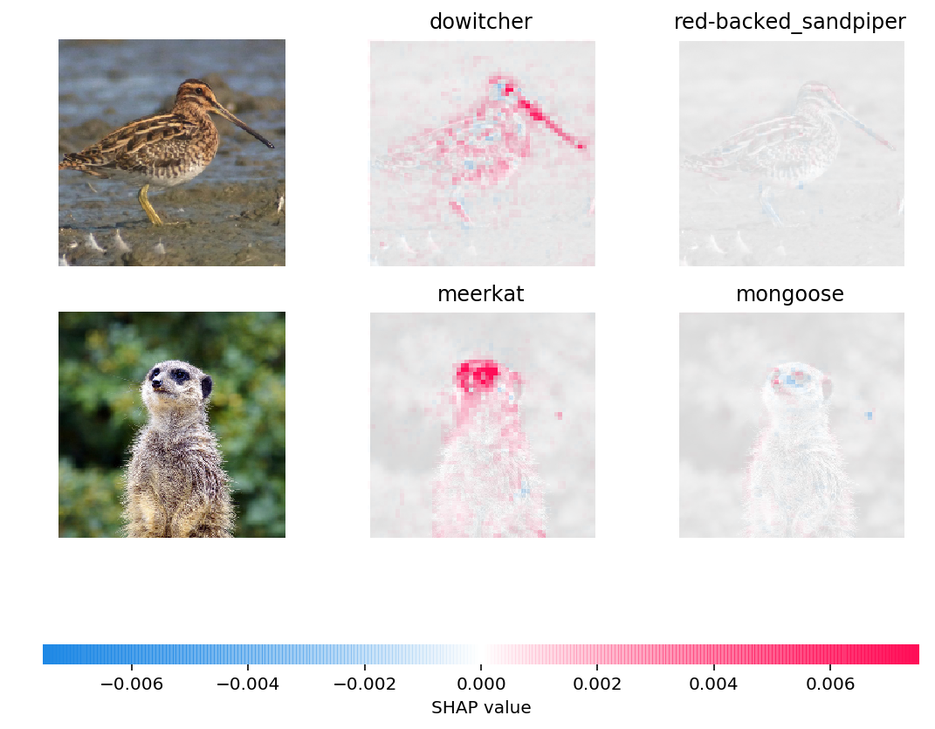

MACHINE LEARNING for Health tech
MACHINE LEARNING EXPLAINABILITY – SHAP
https://christophm.github.io/interpretable-ml-book/
https://github.com/slundberg/shap

Slide 20

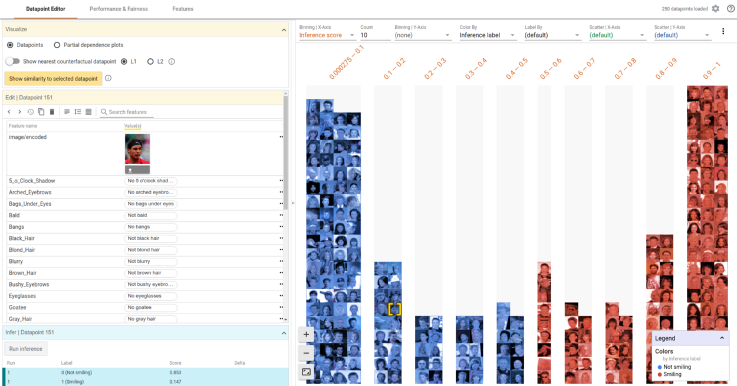
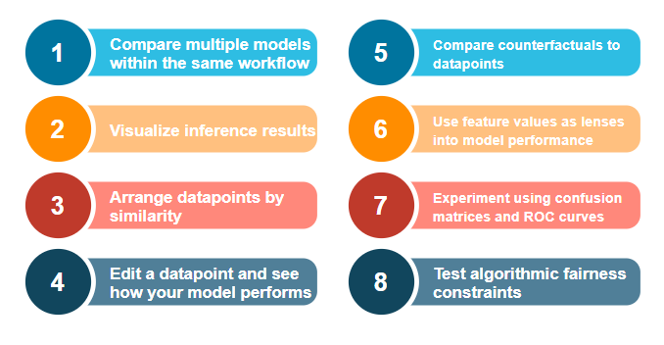
MACHINE LEARNING for Health tech
MACHINE LEARNING EXPLAINABILITY
https://pair-code.github.io/what-if-tool/

